Slide 1
Eye controlled mouse pointer
K. Jaya Vardhan
Ch. Rohit
Ch. Balaji
D. Girish

Slide 2
MEET OUR TEAM
K. Jaya Vardhan
Ch. Rohit
Ch. Balaji
D. Girish
Team Leader
Team member
Team member
Team member

Slide 3
Eye controlled mouse pointer
Introduction
Primary goals
Areas of growth
Timeline
Modules
Summary

Slide 4
INTRODUCTION
To control the mouse with precision, dwell on the Precise mouse button on the launchpad. Then position your eyes on the screen where you want the cursor to be placed. The eye control mouse lets you fine-tune the position of the mouse cursor and then right-click.

Slide 5
PRIMARY GOALS
The primary goal of an eye-controlled mouse pointer is to provide a hands-free way to control a computer for people with physical disabilities. This can be useful for individuals who are unable to use a traditional mouse due to paralysis, tremors, or other conditions.

Slide 6
“I choose a lazy person to do a hard job. Because a lazy person will find an easy way to do it.”
Bill Gates

Slide 7
AREAS OF FOCUS
Accuracy
Ease of Use
The application must be able to accurately track the user's eye movements so that the mouse pointer moves to the correct location.
The application must be easy to use so that people with disabilities can easily control the mouse pointer.

Slide 8
Time line
2013: A system was developed that used eye tracking to select pictograms.
2014: An eye-controlled mouse was developed using Python and C++.
2015: A system was developed that used eye gaze to control the mouse pointer.
2016: A system was developed that used eye tracking to control the mouse pointer with high accuracy.
2017: A system was developed that used eye tracking to control the mouse pointer in real time.
2018: A system was developed that used eye tracking to control the mouse pointer with a natural gaze.
2019: A system was developed that used eye tracking to control the mouse pointer with a single eye.

Slide 9
modules
Opencv
Mediapipe
pyautogui

Slide 10
modules
Opencv:OpenCV is a Python library that allows you to perform image processing and computer vision tasks. It provides a wide range of features, including object detection, face recognition, and tracking. In this OpenCV Tutorial in Python, we'll be learning more about the library.
Mediapipe:
MediaPipe is an open-source framework for building pipelines to perform computer vision inference over arbitrary sensory data such as video or audio. Using MediaPipe, such a perception pipeline can be built as a graph of modular components. MediaPipe is currently in alpha at v0.
Pyautogui:
Python's pyautogui is a package that allows users to create scripts that can simulate mouse movements, click on objects, send text, and even use hotkeys. While not as elegant a solution as Selenium, pyautogui can be used to bypass systems that put up blocks against automated browser use.

Slide 11
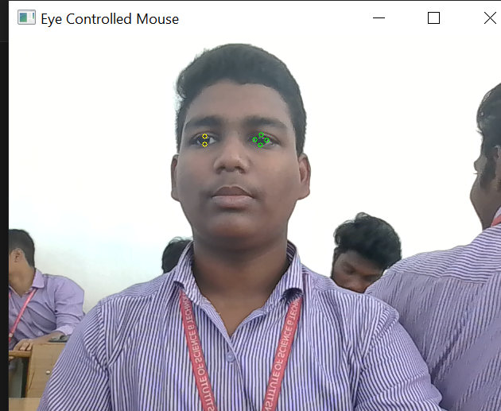
Output of project

Slide 12
SUMMARY
The eye-controlled mouse pointer is a computer interface that allows users to control the cursor on a screen using their eye movements. The system uses a camera to track the user's eye movements and then translates them into cursor movements.

Slide 13
THANK YOU
Cheduluri Rohit
Chedulurirohit@gmail.com

